Slide 1
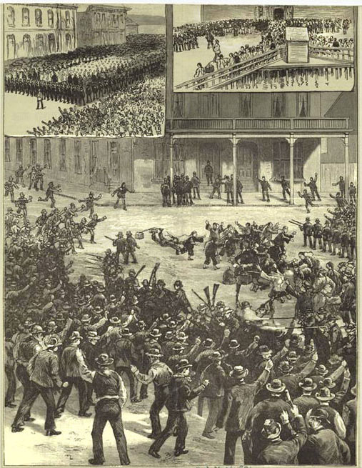
The Anti-Chinese riot in Seattle, 1886, Harper’s Weekly.

Slide 2
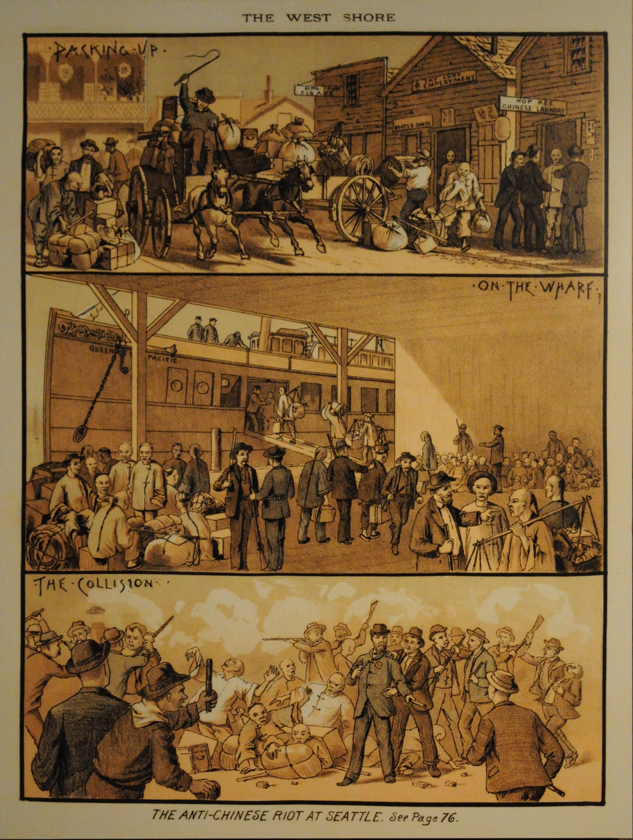
The West Shore, 1886

